Slide 1

Shopick
Final
Team 6 : 이승훈, 신현지, 김희성, Misael

Slide 2
Index
Overview
Hardships
Backend
Frontend
Development process
Lessons Learned

Slide 3

Overview

Slide 4
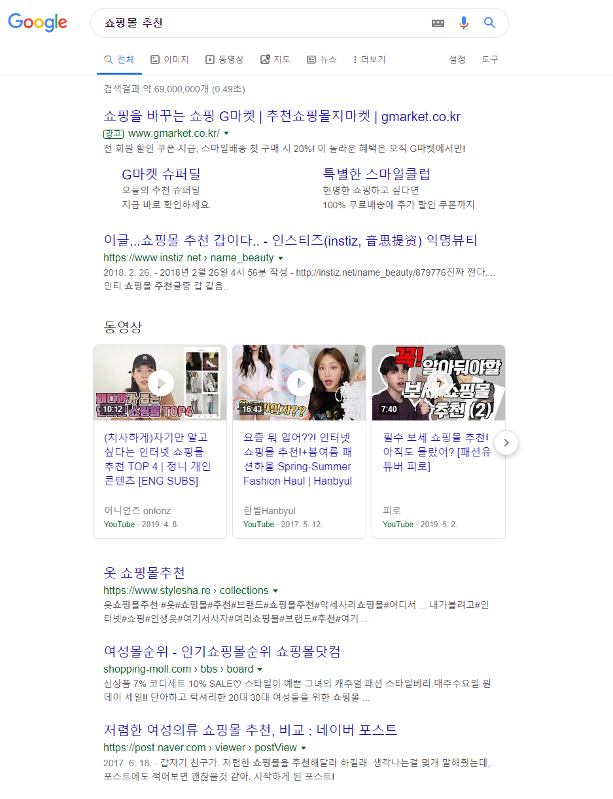

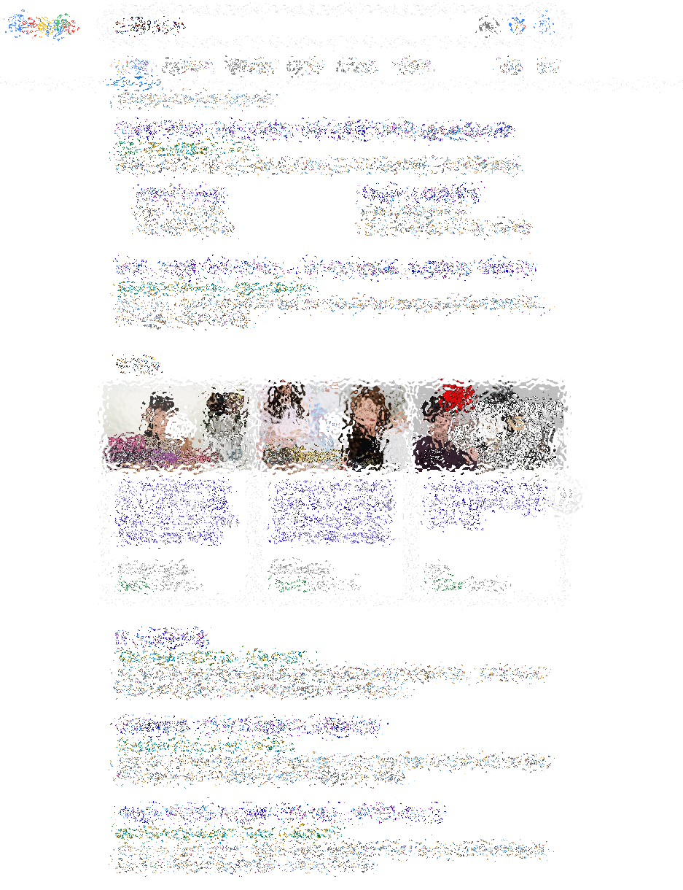
Target System : Recommendations

Slide 5
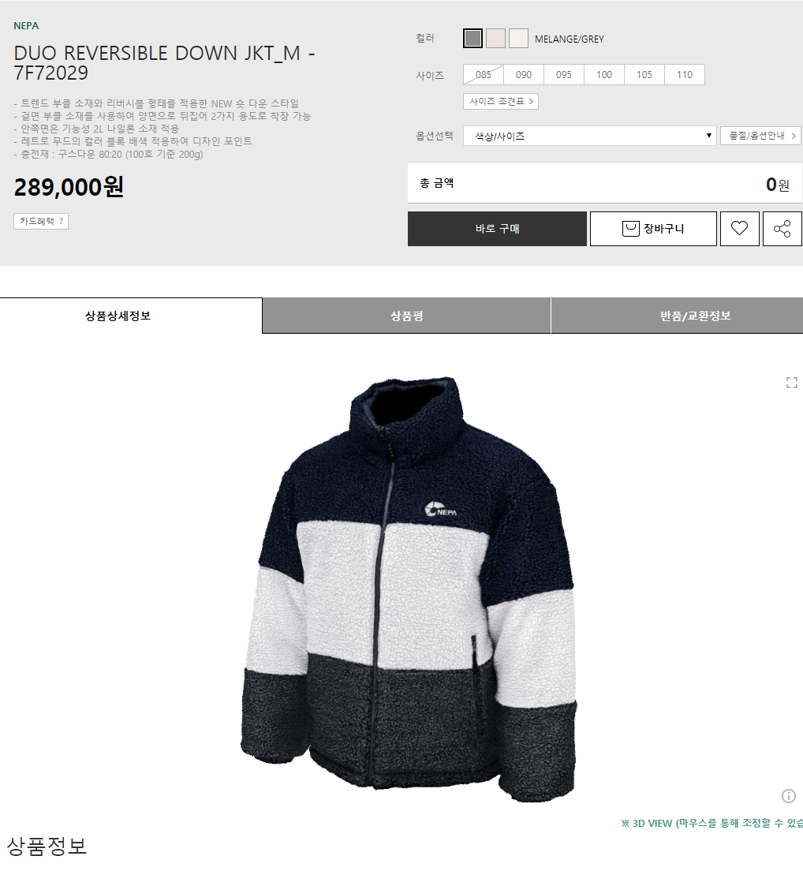
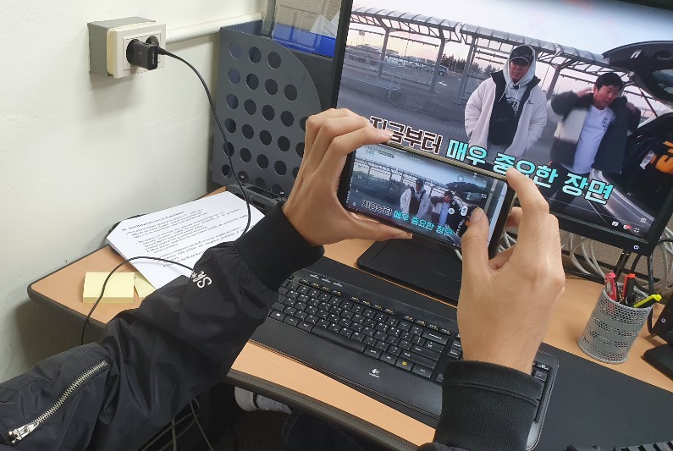
Target System : Real-time feedbacks

Slide 6





Abstract

Slide 7
Roles
Hyunjee Shin
Seunghoon Lee
Deep Learning
Heesung Kim
Php & Android Programming
Misael Zapata
Server & Database

Slide 8

Hardships

Slide 9
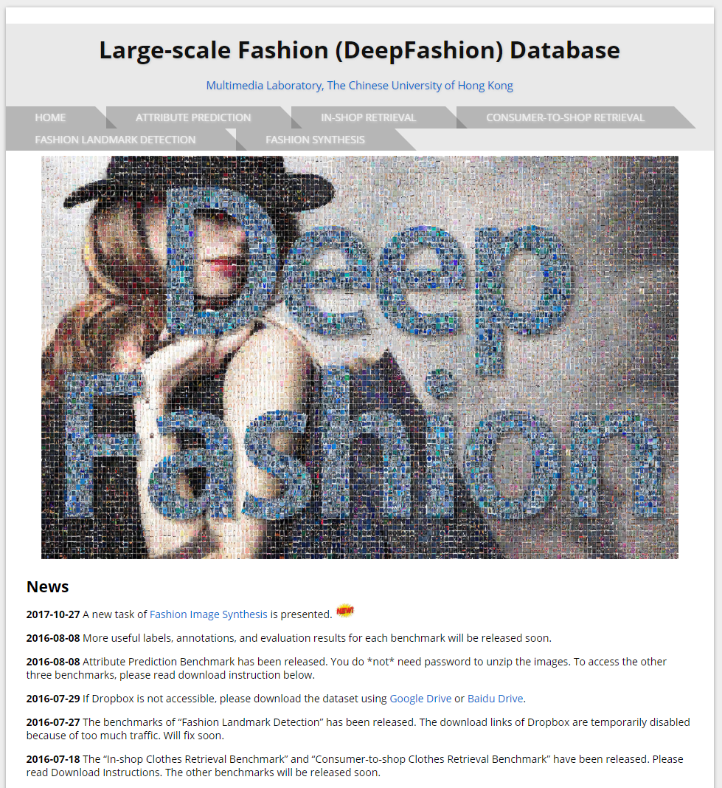
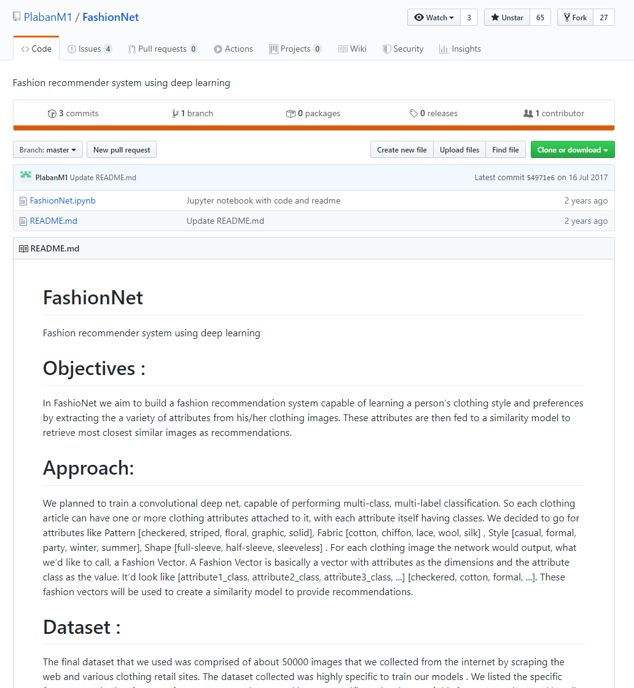
Open source
UNPROVIDED
OUT OF ORDER

Slide 10
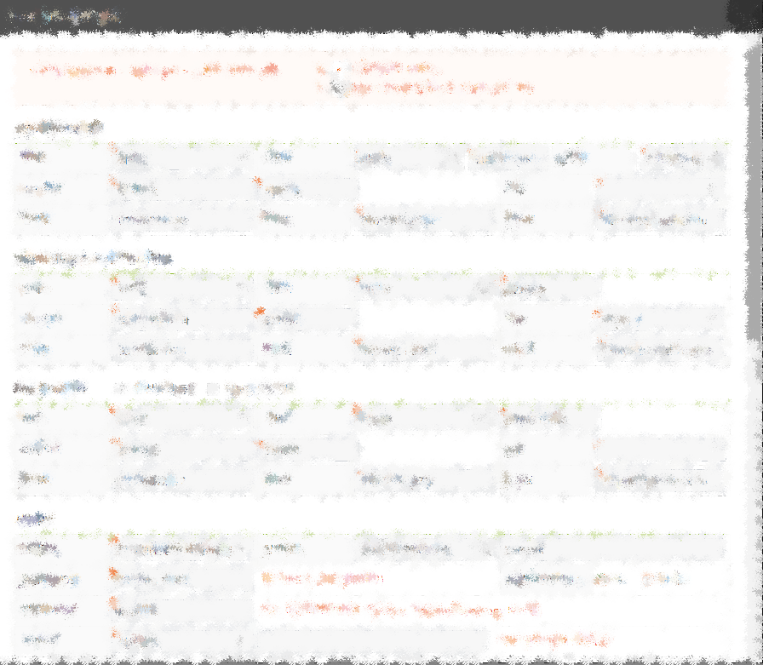
Port of Server PC
Server PC is stated in SKKU
Opening the HOST has been asked but not yet permitted

Slide 11

OVERCOMING HARDSHIPS

Slide 12
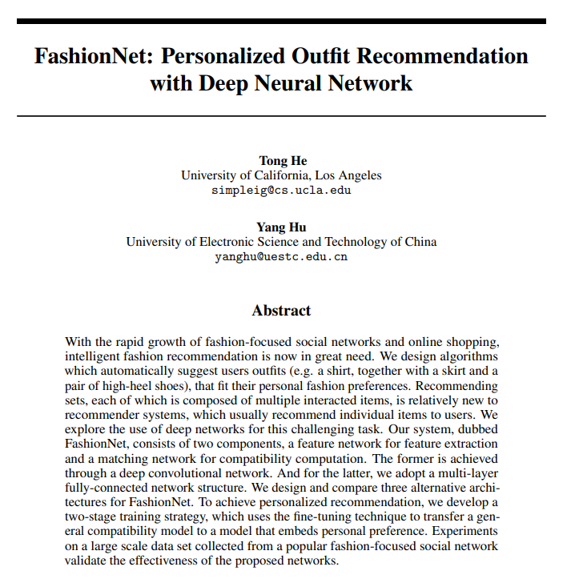
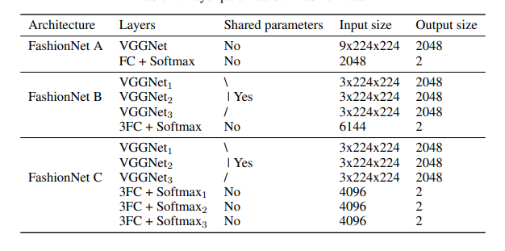
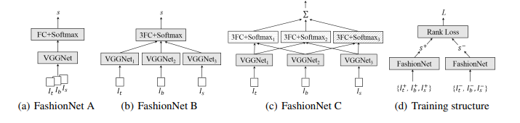
Deep learning
Went through the original paper
Selected FashionNet C
Coded it by referring to the unworking opensource

Slide 13
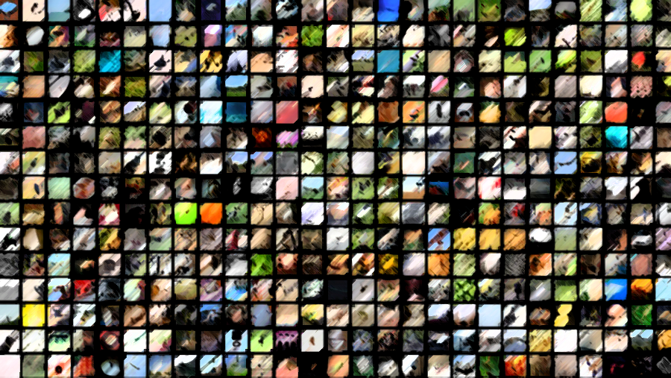
Deep learning Dataset
Made a new dataset categorized into 5 classes,
holding 50K clothing data

Slide 14

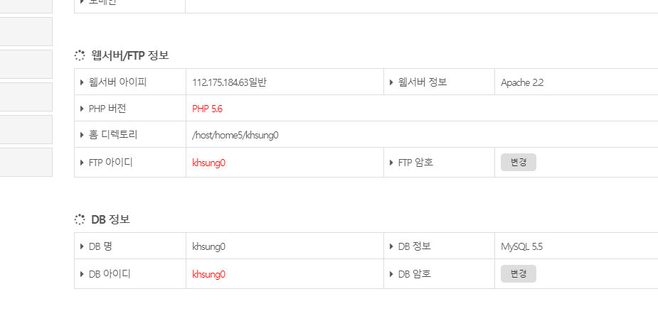
Web Server for prototype testing
A mini database has been put in a web hosting service

Slide 15

Backend

Slide 16

Fashion Tagging
MySQL
Images saved in the server
Scraping.py
Shoppick_Fashion_tag_generator.py
Up to three ‘style tags’ are saved

Slide 17
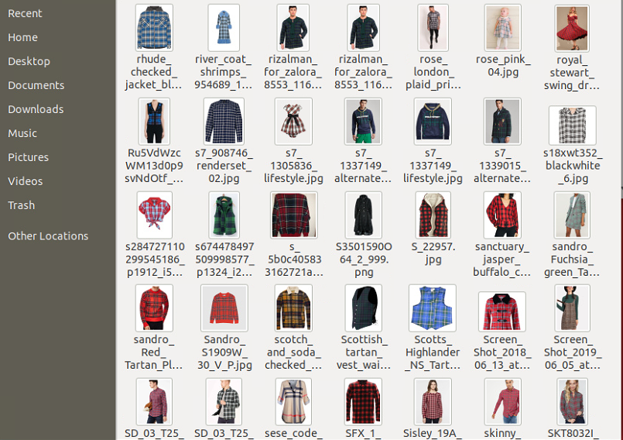
Finding similar clothes
Clothes_id | Name | Style | gotostore_url
0 | Sports0 | Sports | https://store.musinsa.com/app/product/d...
1 | Casual0 | Casual | http://www.lotte.com/...
2 | sports1 | sports | http://www.11st.co.kr/product/SellerProductDeta...
/Deep-fashion/retail_shops

Slide 18
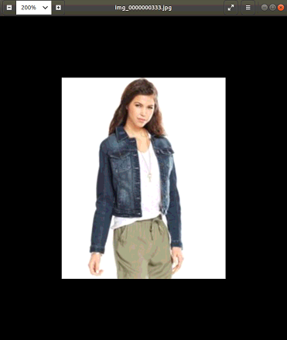
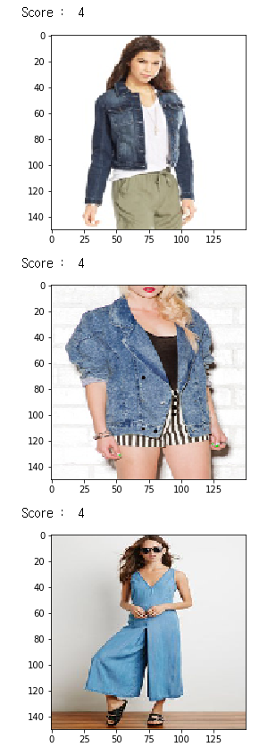
Finding similar clothes
MySQL
Images saved in the server
user_search_images.py
Shoppick_Similarity_function.py
Pass on up to 10 clothes that matches

Slide 19

Frontend

Slide 20

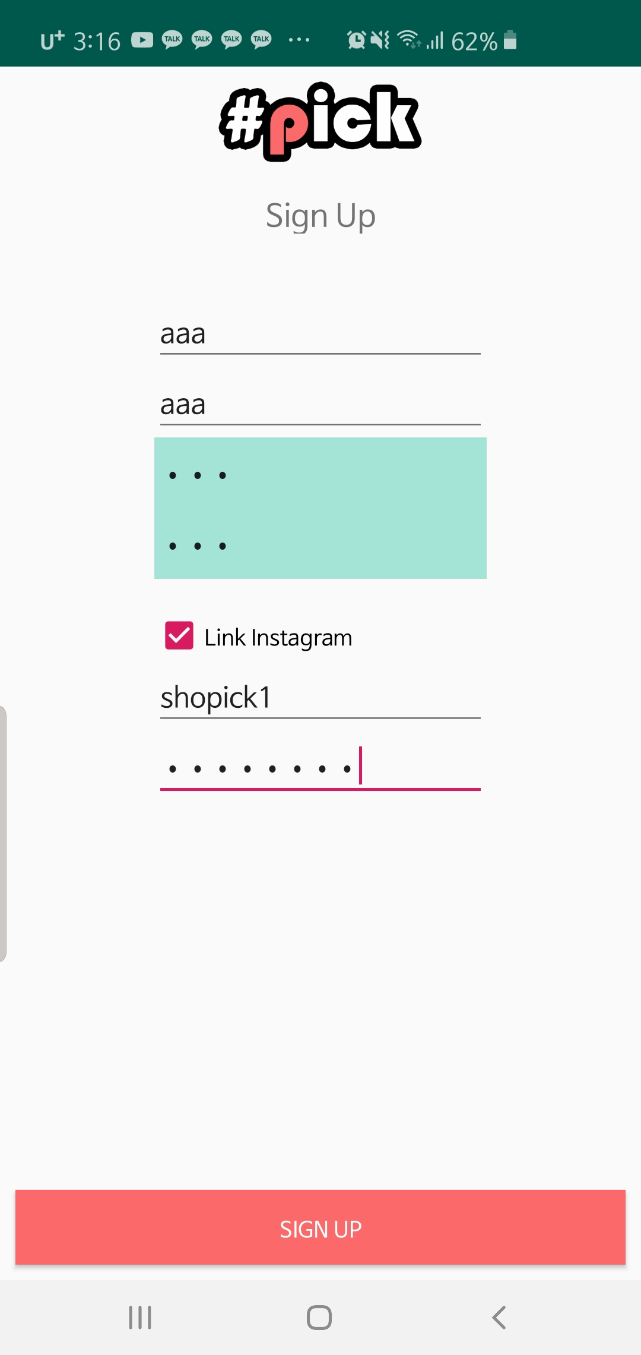
Login & Sign Up

Slide 21

Searching with Tags

Slide 22

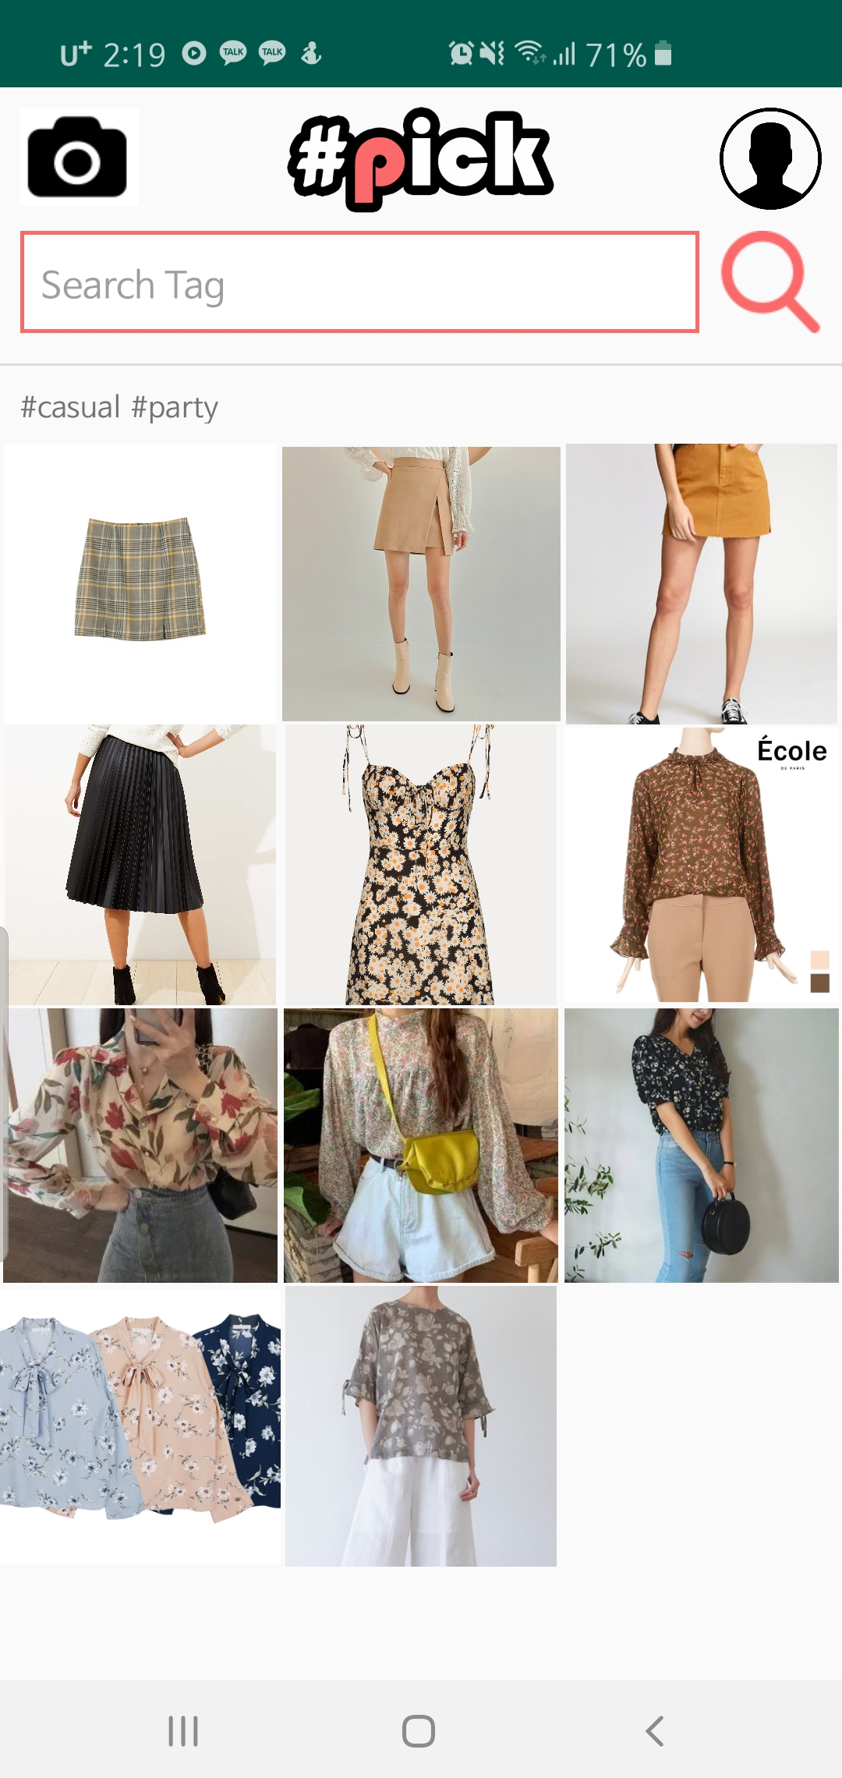
Personal Style Tag

Slide 23

Trial Video

Slide 24

Development process

Slide 25

Expected Schedule
Nov
Nov
9
20
Nov
28
Deep Learning
& Database
Back-end
Integration
Final
Integration
Nov
5
Basic
Front-end

Slide 26
Real Schedule
Nov
Nov
16
23
Dec
8
Deep Learning
& Database
Back-end
Integration
Final
Integration
Nov
Dec
5
6
Basic
Front-end
Front-end
Integration

Slide 27

Lessons Learned

Slide 28

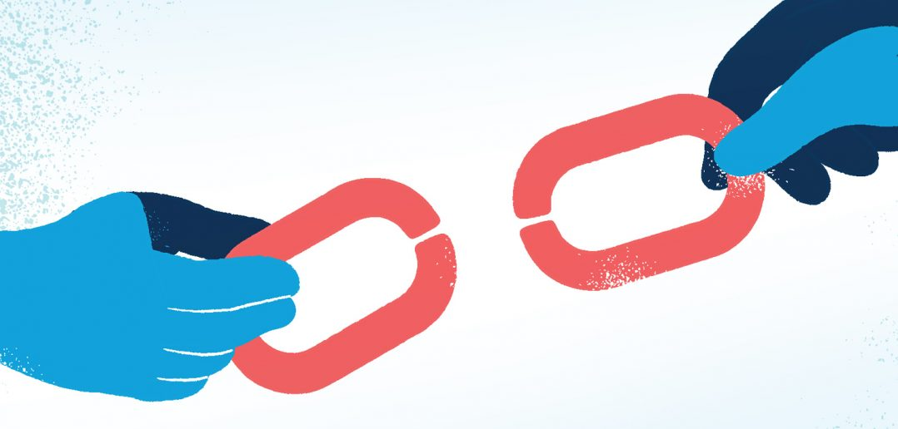
Lessons Learned
Communication and having abstract
knowledge of other parts is essential
Linking each parts is harder than thought

Slide 29
Thank you

